Slide 1
September 2026
Can news improve Nasdaq 100 forecasts?
Deep Learning
Group 13, Tel Aviv University
Tom Weitman and Elad Kulman

Slide 2
Motivation
Nasdaq-100 tracks 100 large non-financial companies
including well-known companies like Apple, Microsoft, Nvidia, Amazon, and Meta
Many factors influence the index
(Actual correlation are unknown and constantly changes )
News may contain useful signals about these movements
Can a deep-learning model understand and use these relationships?

Slide 3
Existing Work
  2018–2022: LSTM/GRU, CNN-LSTM and attention-based recurrent models dominated financial forecasting.
  2021–2024: Transformers and specialized time-series architectures arrived: TFT, Informer/Autoformer, PatchTST, TimesNet, iTransformer and TimeMixer.
  2024–2026: The field moved toward time-series foundation models such as Chronos, TimesFM and Moirai, along with finance-specific pretraining, graph neural networks, text/news models such as FinBERT, regime-aware models and probabilistic forecasting.

Slide 4
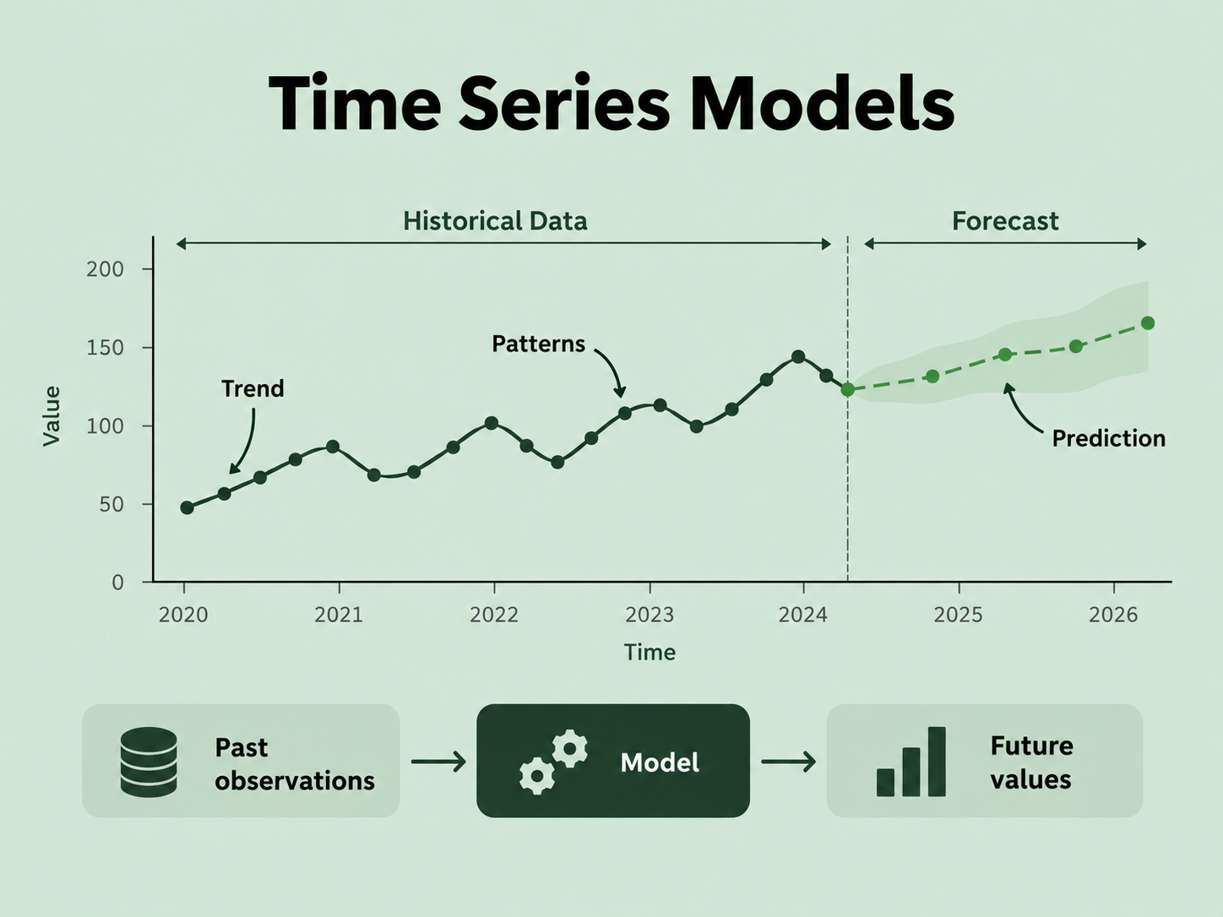
Time Series Models
sequence of observations recorded over time | Order matters

Slide 5
Chronos-2
  A pretrained time-series foundation model
  Supports additional inputs
  Can be efficiently fine-tuned with LoRA
  Open source
  Pretrained with various data
119.5M base parameters
512-session context
21 forecast quantiles

Slide 6
General Market Data
  QQQ history: Returns, overnight gaps, volume, momentum, and volatility.
  Related markets: Nasdaq volatility (VXN), Treasury bonds (TLT), and corporate bonds (HYG).
  Macroeconomics: Interest rates, yield curves, real yields, and inflation.
  Financial Events: Fed meetings, inflation releases, employment reports, and options expiration.
  External signals: Economic-policy uncertainty, Fed statement tone, and SEC filing activity.

Slide 7
News Data - GDELT
  A free open platform that tracks global news and converts it into data on topics, events, and tone.
  GDELT delivers news not just as text, but as structured daily numbers that a model can use directly.
We focus on six topics:
  AI
  Semiconductors
  Federal Reserve policy
  Inflation
  big-tech earnings
  recession

Slide 8
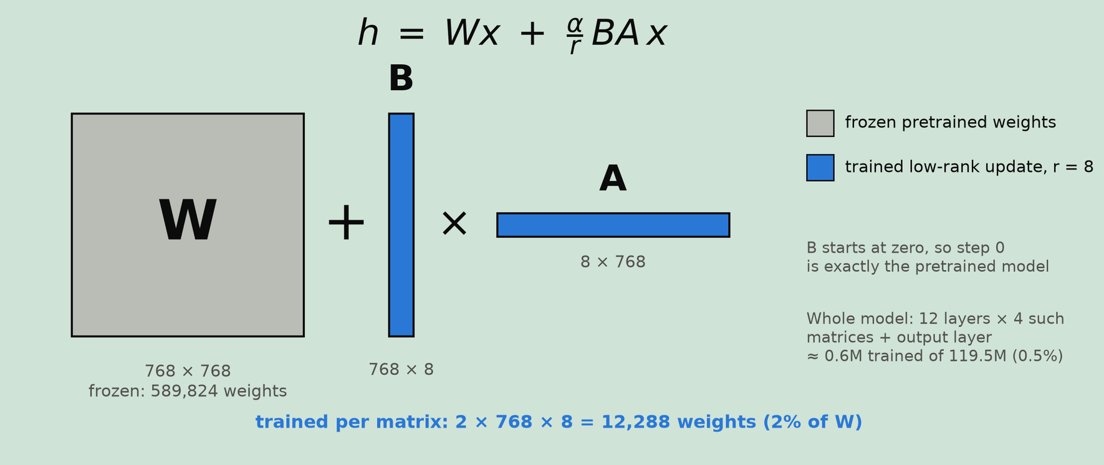
LoRA - Low-Rank Adaptation
fine-tune a large pretrained model without updating all of its weights

Slide 9
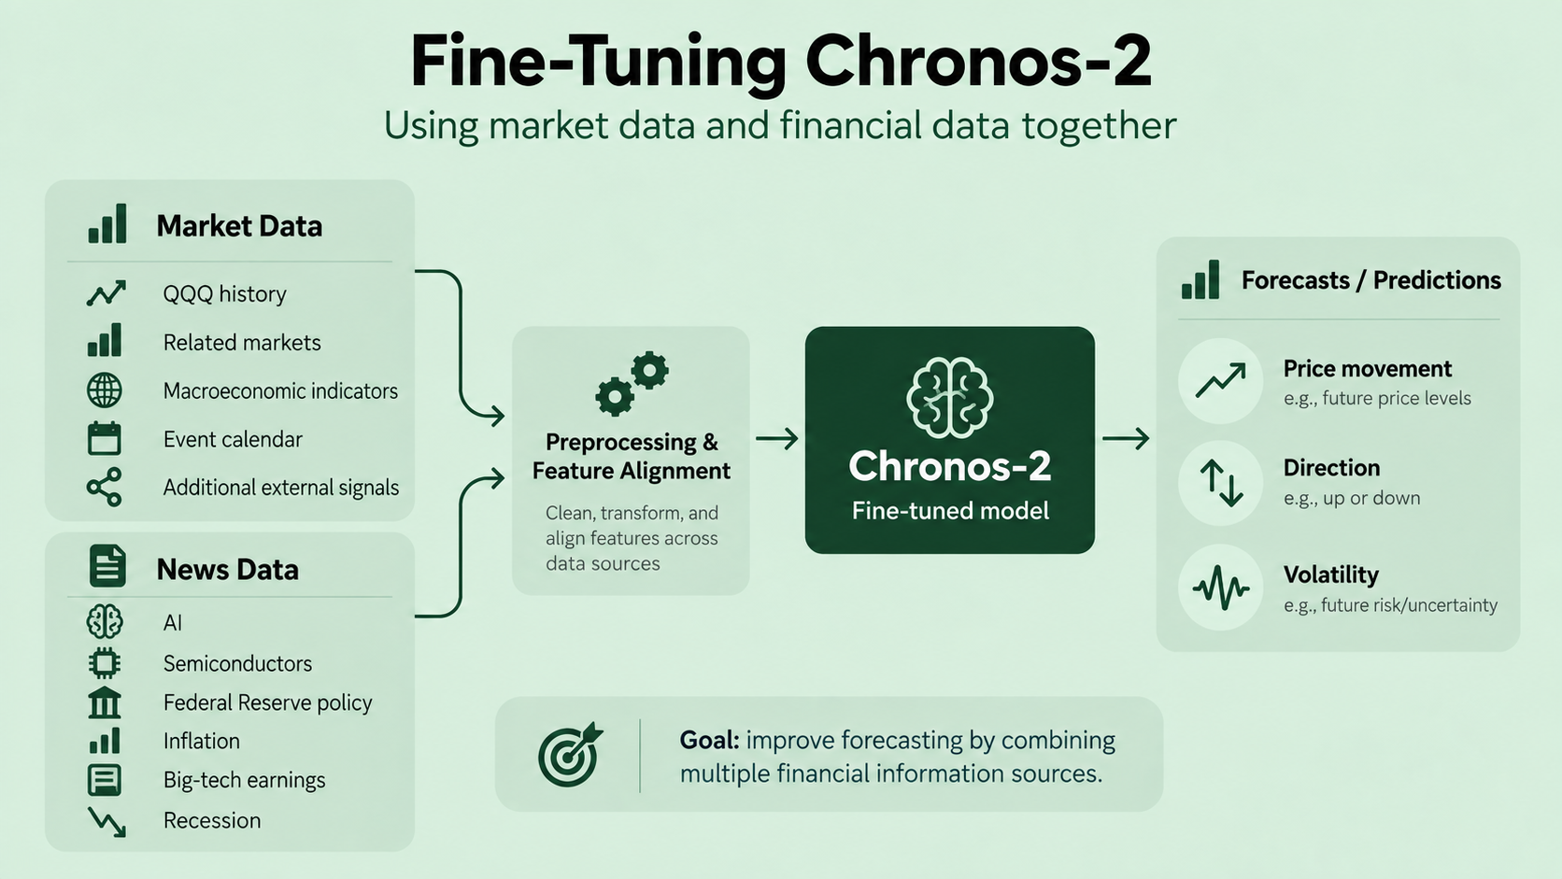

Slide 10
Training and Evaluation Process
Two experiment rounds:
An initial 18-run source comparison
Followed by 108 fine-tuning runs covering four evaluation years and three random seeds.
After training:
We freeze the weights, forecast five separate daily returns at each origin, and advance five trading sessions.

Slide 11
How we score a forecast
The model outputs 21 quantiles for each of the next five days
Weighted quantile loss: rewards the whole distribution, lower is better
Coverage: the 10 to 90 percent band should contain 80 percent of outcomes
Direction is compared with “always up”, not with 50 percent:
in 2025, always-up scores 57 percent

Slide 12
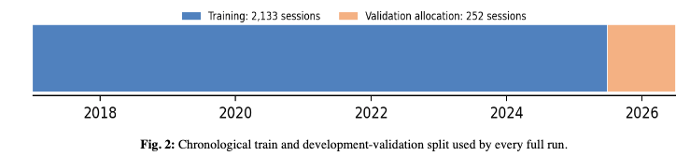
Fine Tune Run A
  The model receives observations through the previous QQQ close and produces forcast for each of the next five trading-day returns.
  After those five realized sessions, the origin advances by five sessions. Fifty non-overlapping origins therefore score 250 daily outcomes; the final two sessions of the 252-session allocation cannot form a complete block
  Fine tune with different news source sepertly and compare to control
  Check both direction and index price predictions

Slide 13
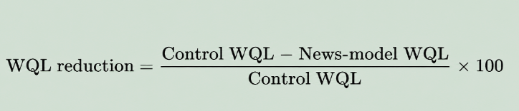
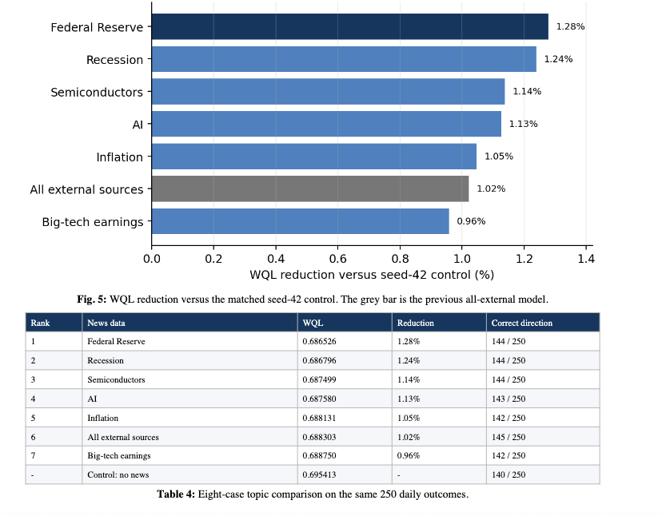

Slide 14
Fine Tune Run B
How we find what the model uses
Take one input. Replace its 512 days with the same input from a different random week. Forecast again.
Forecast got worse → the model was using it
No change → ignored
Forecast got better → the input was misleading it

Slide 15
42 inputs - One surprising standout
News signals
Mostly close to zero → little evidence of meaningful use
VXN change
Large negative effect → Removing it improves the forecast
The pretrained model doesn't strongly exploit our news signals.
Instead, it reacts strongly to volatility.

Slide 16
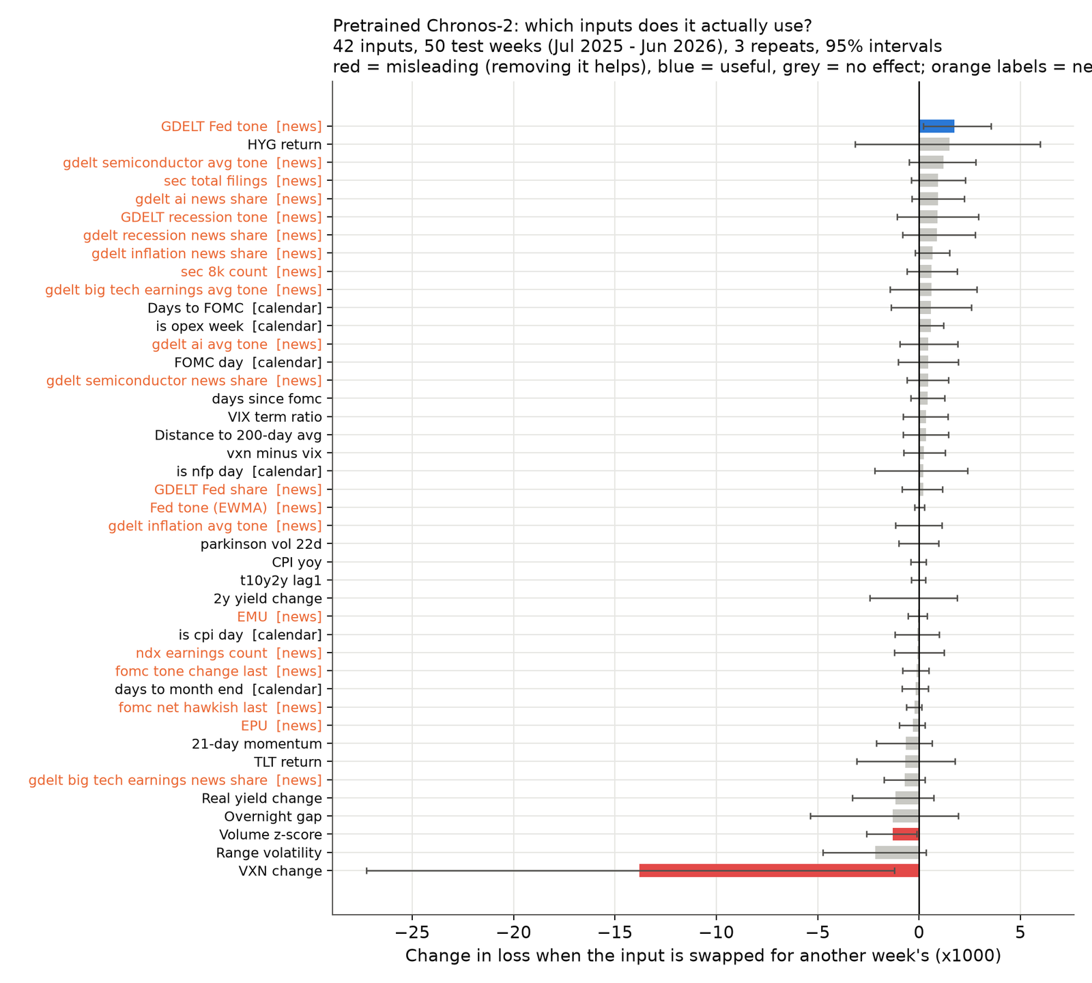

Slide 17
Does fine-tuning change what the model uses?
The model's input-usage pattern stays remarkably similar
0.91 correlation
Then underneath:
VXN: still misleading
News: little evidence of meaningful use

Slide 18
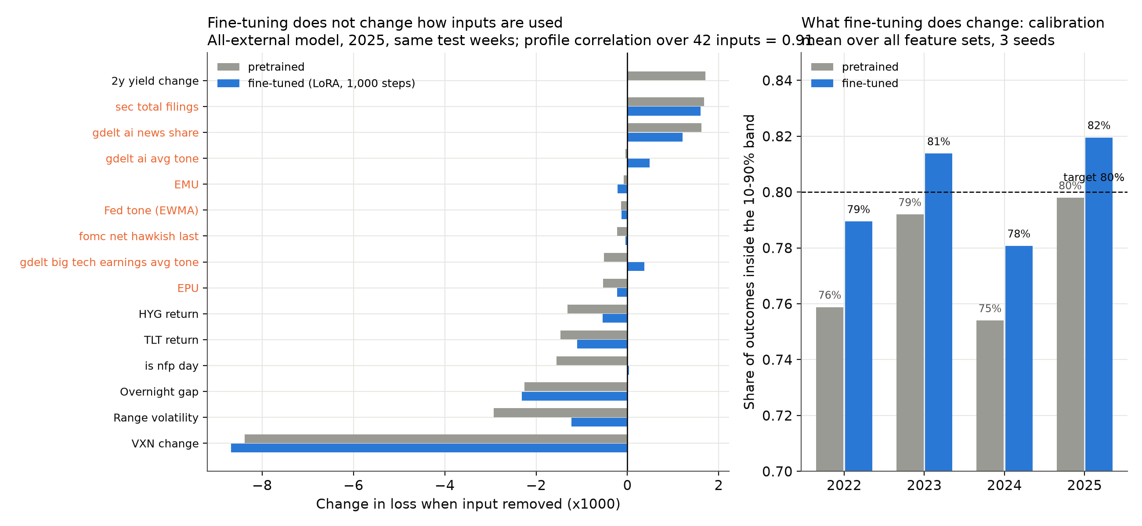

Slide 19
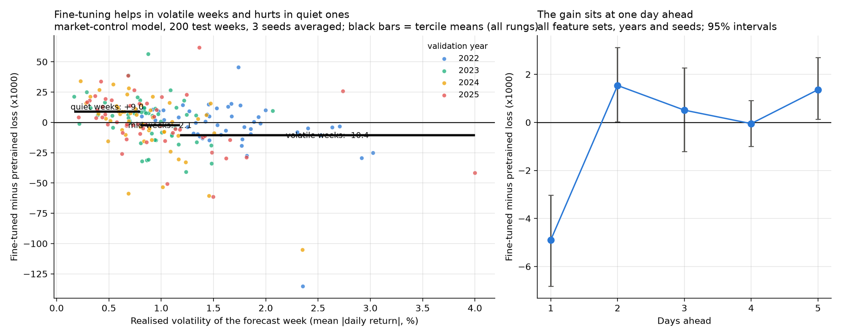
What does fine-tuning change?
Fine-tuning helps when markets are volatile - but hurts when they're calm

Slide 21
Conclusions
  No particular news source improved Nasdaq-100 forcasting
  Fine-tuning learns the scale of returns, not the meaning of the inputs: it widens the bands
  Fast market inputs like the VXN change hurt the pretrained model, and fine-tuning does not fix that

Slide 22
Future work
  Full fine-tuning with a larger budget
  Longer news history and richer text
  Improve how we represent news.
  Compare news volume and average tone with richer features, such as unexpected changes in coverage, headline novelty, or relevance to major Nasdaq-100 companies.

